Slide 1
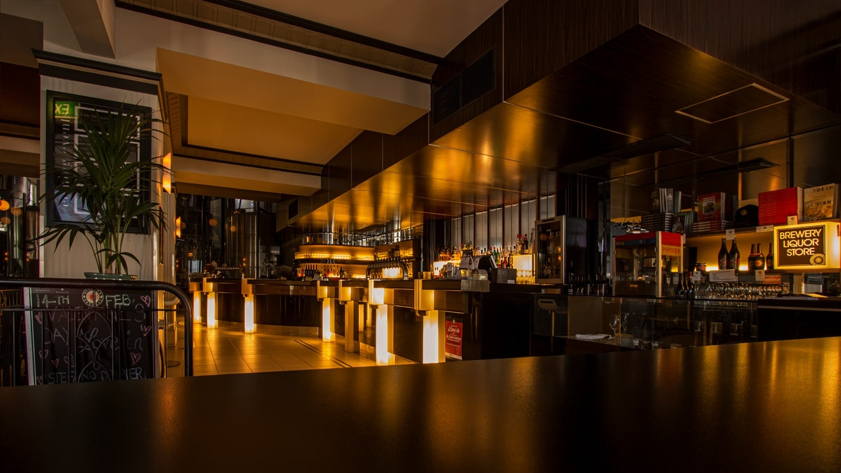

Effects of COVID-19 on the Service Industry
By: Ryan Grant
Notes:
Links:
https://www.pexels.com/photo/alcohol-architecture-bar-beer-260922/

Slide 2
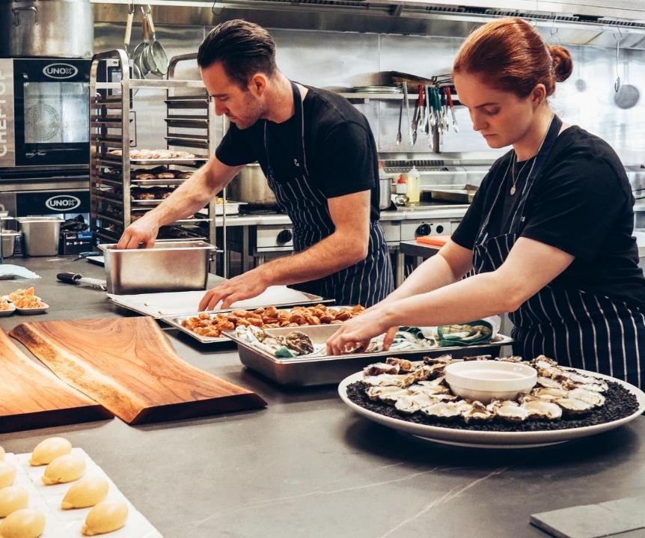


The State of the Industry
More than 110.000 restaurants and bars closed, either temporarily or Permanently.
2.5 Million jobs erased compared to pre-pandemic levels
Foodservice industry sales in 2020 fell by $240 billion from an expected $899 billion.
Notes:
Links:
https://www.pexels.com/photo/chef-holding-white-tea-cup-887827/https://www.pexels.com/photo/chef-holding-white-tea-cup-887827/

Slide 3

Notes:
Links:
https://www.pexels.com/photo/pendant-bulb-photo-750843/

Slide 4

Notes:
Links:
https://www.pexels.com/photo/man-and-woman-wearing-black-and-white-striped-aprons-2696064/

Slide 5
Notes:
Links:
https://unsplash.com/photos/SiQgni-cqFg
https://unsplash.com/photos/GSD9VoG6f-U
https://unsplash.com/photos/DdglEoIC2y4

Slide 6

Notes:
Links:
https://unsplash.com/photos/Orz90t6o0e4
https://www.pexels.com/photo/plate-of-yellow-food-with-green-relish-2297961/
https://www.pexels.com/photo/top-view-photo-of-food-on-top-of-baking-rack-2741448/
https://www.pexels.com/photo/salad-on-a-plate-2097090/
https://www.pexels.com/photo/noodle-soup-with-meat-and-vegetables-in-white-ceramic-bowl-4110421/
https://www.pexels.com/photo/noodle-soup-with-meat-and-vegetables-in-white-ceramic-bowl-4110421/
https://www.pexels.com/photo/cooked-food-704569/

Slide 7
Notes:
Links:
https://www.pexels.com/photo/top-view-of-food-1640772/
https://www.pexels.com/photo/close-up-photo-of-a-cheese-burger-1633578/
https://www.pexels.com/photo/burrito-chicken-delicious-dinner-461198/
https://www.pexels.com/photo/blur-breakfast-close-up-dairy-product-376464/

Slide 9
Notes:
Links:
https://pixabay.com/illustrations/cook-boy-cooking-kitchen-chef-1773638/

Slide 10
THANK YOU
Notes:
Links:
https://www.pexels.com/photo/alcohol-architecture-bar-beer-260922/

